Slide 1
Digital Portfolio
STUDENT NAME: ARUL MANI A
REGISTER NO AND NMID: 24132161802521012
DEPARTMENT: B.Sc., COMPUTER SCIENCE
COLLEGE: GOVERNMENT ARTS AND SCIENCE COLLEGE THIRUVENNAINALLUR/ ANNAMALAI

Slide 2
ANIMATE ON SCROLL

Slide 3
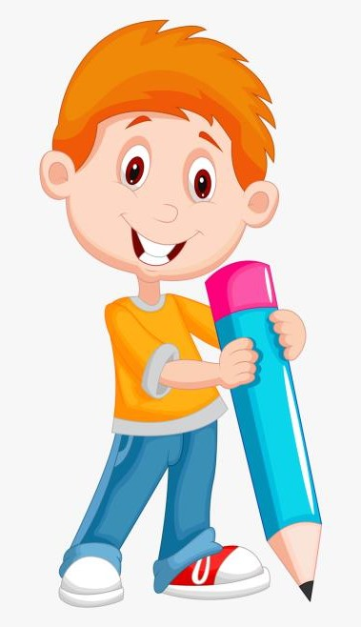

AGENDA
Problem Statement
Project Overview
End Users
Tools and Technologies
Portfolio design and Layout
Features and Functionality
Results and Screenshots
Conclusion
Github Link
3/21/2024 Annual Review

Slide 4

PROBLEM STATEMEN
Problem statement
Modern websites often rely on static content that fails to fully engage users. Traditional web pages can feel monotonous, leading to reduced user interaction and higher bounce rates. There is a need for an interactive solution that enhances user experience by providing dynamic, scroll-triggered animations. The challenge is to design a web interface where animations respond seamlessly to user scrolling, creating a visually appealing and engaging journey while maintaining performance across devices and screen sizes.

Slide 5

PROJECT OVERVIEW
The Animation Scroll Project aims to create an interactive web experience where animations are triggered and controlled by user scrolling. Unlike traditional static web pages, this project focuses on engaging users through dynamic visual effects that respond in real-time as they navigate the page. The project will involve designing web elements that animate based on scroll position, such as fading content, sliding images, moving graphics, or scaling elements. It will leverage modern web technologies like HTML, CSS, and JavaScript, along with libraries such as GSAP (GreenSock Animation Platform) or ScrollMagic, to implement smooth and responsive animations.
The main objectives of the project are: To enhance user engagement by providing an interactive browsing experience. To demonstrate smooth, scroll-triggered animations that maintain website performance. To create a visually appealing interface suitable for portfolios, product showcases, storytelling, or marketing websites. To ensure responsiveness and compatibility across different devices and screen sizes.

Slide 6

Users
1. Website Visitors / General Users: People browsing websites who benefit from an engaging and interactive experience. Users who prefer visually appealing content over static pages. 2. Content Creators / Designers: Web designers and UI/UX designers looking to showcase interactive elements. Marketing teams or storytellers who want to present content dynamically. 3. Businesses / Organizations: Companies building portfolios, product showcases, or promotional websites. E-commerce sites aiming to highlight products with scroll-triggered animations. 4. Developers / Students: Developers and students learning web animation techniques. Individuals who want to implement scroll-based animations in projects or portfolios.

Slide 7
TOOLS AND TECHNIQUES
Tools: 1. HTML5 & CSS3 – For structuring content and styling animations. 2. JavaScript (Vanilla JS) – To control and trigger animations on scroll. 3. Animation Libraries (optional but powerful): GSAP (GreenSock Animation Platform) – Smooth and advanced animations. ScrollMagic – To trigger animations when elements come into view. Locomotive Scroll – Smooth scrolling effects and parallax.
Techniques: 1. Scroll-triggered animations – Animations activate as users scroll. 2. Parallax effect – Background and foreground move at different speeds. 3. Fade-in / Fade-out – Elements appear/disappear smoothly on scroll. 4. Transformations – Scaling, rotating, sliding, and translating elements. 5. Pinning & Sticky effects – Elements stay fixed while the rest scrolls.

Slide 8
POTFOLIO DESIGN AND LAYOUT
1. Overall Concept: The portfolio should be interactive, visually appealing, and showcase scroll-triggered animations effectively. The layout should guide the user through the content naturally, with animations enhancing storytelling rather than distracting. 2. Layout Structure: Header / Hero Section: A bold, animated introduction with your project title and tagline. Subtle scroll-triggered effects, like text sliding or fading in. About / Project Overview Section: Explains the purpose of the project. Use animations like fade-ins or sliding cards to present content. Demo / Showcase Section: Embed live or screenshot examples of the scroll animations. Use interactive panels or image carousels triggered by scrolling. Tools & Techniques Section: Display icons and descriptions of the technologies used. Add hover or scroll-based animation for each tool.
3. Design Principles: Consistency: Keep fonts, colors, and animation styles consistent. Minimalism: Avoid excessive animations that distract from content. Responsiveness: Ensure animations work on all devices (desktop, tablet, mobile). Performance: Optimize animations to maintain smooth scrolling and fast load times. Hierarchy: Prioritize important sections with prominent animations. 4. Interactive Features: Scroll-triggered reveal animations (fade, slide, scale). Parallax scrolling for background/foreground elements. Animated navigation indicators to show scroll progress. Sticky or pinned sections for key project highlights. 5. Visual Style: Modern, clean typography. Subtle color palette with accent colors for interactive elements. Smooth transitions for a professional feel. Use icons and minimal graphics to enhance comprehension.
8

Slide 9
FEATURES AND FUNCTIONALITY
Features: 1. Scroll-Triggered Animations: Elements animate (fade, slide, scale, rotate) as the user scrolls. 2. Parallax Effects: Background and foreground elements move at different speeds for depth. 3. Interactive Sections: Clickable or hoverable elements that reveal more content. 4. Sticky / Pinned Elements: Important content remains fixed while the user scrolls. 5. Lazy Loading of Elements: Content loads dynamically when it comes into view to improve performance. 6. Responsive Design: Animations and layout adjust smoothly across desktop, tablet, and mobile. 7. Smooth Scrolling: Provides a seamless scrolling experience without jarring jumps.
Functionality: User Engagement: Animations make the content interactive and visually appealing. Enhanced Visual Experience: Parallax, transitions, and motion effects create depth and focus. Performance Optimization: Lazy loading and smooth animations reduce lag and improve page load speed. Cross-Browser Compatibility: Animations work on major browsers (Chrome, Firefox, Edge, Safari). Accessibility: Animated elements degrade gracefully for screen readers or users with motion sensitivity. Easy Maintenance: Modular animation code allows easy updates or adding new scroll effects.

Slide 10

RESULTS
1. Enhanced User Engagement: Users experience a visually interactive website that keeps them engaged while scrolling. Scroll-triggered animations make content more dynamic and interesting. 2. Improved Visual Storytelling: Information and content are presented in a sequential, animated manner, making the website more appealing and easier to understand. 3. Smooth and Responsive Experience: Animations work seamlessly across devices (desktop, tablet, mobile) without lag or glitches. Smooth scrolling and optimized animations ensure performance is maintained. 4. Showcase of Skills and Techniques: Demonstrates proficiency in web technologies such as HTML, CSS, JavaScript, and animation libraries like GSAP or ScrollMagic. Highlights ability to implement interactive UI/UX elements effectively. 5. Portfolio and Presentation Ready: The project can be included in a developer’s or designer’s portfolio to showcase modern, interactive web design skills.
3/21/2024 Annual Review
10

Slide 11
CONCLUSION
The Animation Scroll Project successfully demonstrates how scroll-triggered animations can enhance user engagement and improve the overall web browsing experience. By integrating interactive visual effects, smooth transitions, and responsive design, the project transforms static content into a dynamic storytelling platform. It highlights the effective use of modern web technologies and animation libraries, showcasing both technical proficiency and creative design skills. Overall, the project proves that thoughtful animation combined with user-centric design can significantly elevate website aesthetics, usability, and interactivity.
11

